Slide 1
Creating Accessible Content in Microsoft Office 2010
NC Basic Skills Instructor Training Academy
2012

Slide 2
VLC Professional
Development Center
For more information about the Professional Development Center contact:
Jennifer Jones
(919) 866-5636
jjones4@waketech.edu
Session Resources:
vlcprofessionaldevelopment.pbworks.com

Slide 3
Remember the Fundamentals
Structure
  Build a true structure for navigation; not just a visual hierarchy.
    Use Heading Styles in Word.
    Use Slide Titles and Layouts in PowerPoint
Alt Text
  Provide alternative text for all images, diagrams, and tables.

Slide 4
Fundamentals Continued
Color Contrast
  Do not use color alone to convey meaning.
  Select Design Themes in PowerPoint with color contrast in mind.
Text and Fonts
  3 or less font changes on a page or presentation.

Slide 5
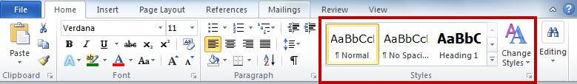
Document Structure
Build document structure with Styles
Typically, only one Heading 1 style per document.
  Reserved for Title of the document.
Heading 2 is used for main topics within the document.

Slide 6
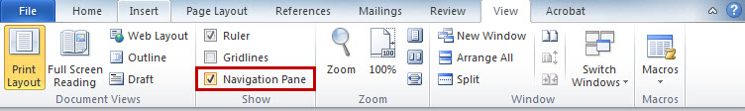
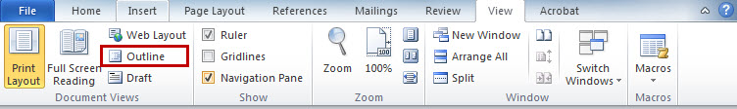
Verifying Document Structure
Use the Navigation Pane in Word 2010
  In Word 2007, this feature is called Document Map
Use the Outline View

Slide 7
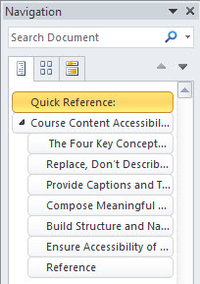
The Navigation Pane
Text that is styled as a heading appears in the Navigation Pane.
The Navigation Pane provides a quick look at the structure of a document.

Slide 8
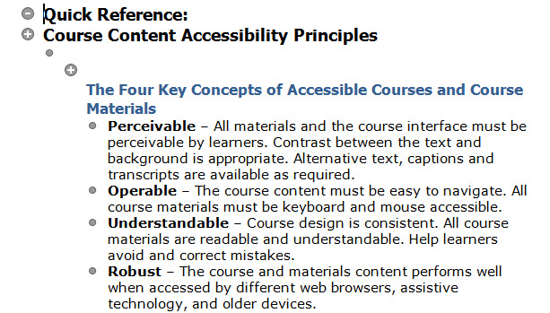
Outline View
All text is displayed in the Outline View.
Outline View provides a detailed look at the structure of a document.

Slide 9
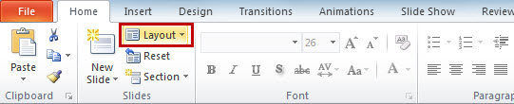
Presentation Structure
All slides must have a Title.
  Slide titles equate to heading styles.
Use the default Slide Layouts in PowerPoint.
  Do not insert text boxes.

Slide 10
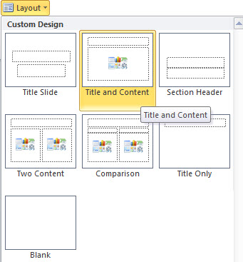
Slide Layouts
The default layouts enable you to create accessible content.
With the exception of the Blank layout.
Why is this one not accessible?

Slide 11
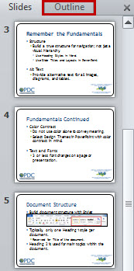
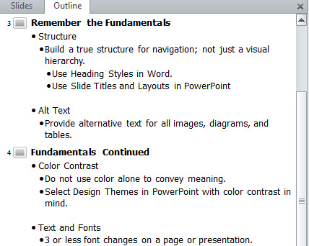
Verifying Presentation Structure
Use the Outline tab.
  Only text that appears in the outline view or is included as alt text for an image is accessible to screen readers.

Slide 12
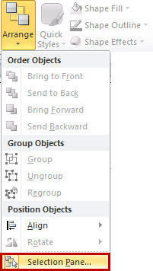
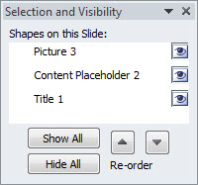
Verifying Slide Reading Order
Use the Selection Pane
  Available on the Home tab:
  Elements are read in order starting at the bottom of the list and moving up.

Slide 13
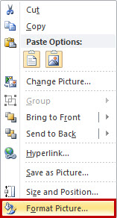
Adding Alternative Text to Images
In Word or PowerPoint 2010:
  Right-click on any image, graphic, chart, or table.
  Select the Format option.

Slide 14
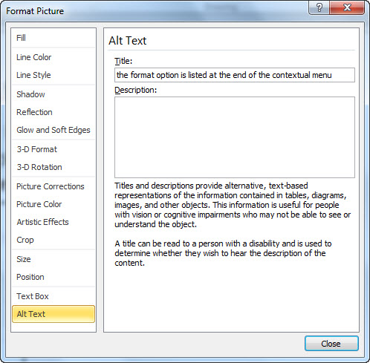
Adding Alternative Text Continued
  Select the Alt Text tab.

Slide 15
Writing Alternative Text
Alternative Text is entered in the Title text box.
  80 characters or less is preferred; no more than 120 characters can be read by screen readers.
Long Descriptions are entered in the Description text box.
  If you are not using the Description area, make sure it is empty.

Slide 16
The Accessibility Checker
Identifies accessibility issues in documents and presentations.
Provides step-by-step instructions for fixing any errors or warnings.
Included in Word, PowerPoint, and Excel 2010.

Slide 17
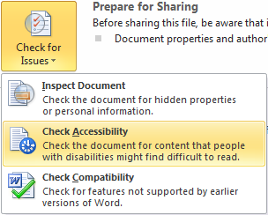

Running the Accessibility Checker
  If the document or presentation was saved using 2007 or older versions of Word or PowerPoint you will need to Convert the file first.
From the File Menu:
  Select Info
  Click Check for Issues
  Choose Check Accessibility

Slide 18
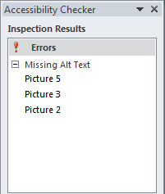
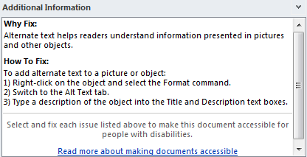
The Accessibility Checker Pane
Click on an error name and you will be taken to that location in the file.
Instructions for fixing the error are provided by the Checker.

Slide 19
Questions?

