Slide 1

Teaching
with iPads

Slide 2
Session Overview
Getting started with using iPads
Methods of integrating iPads in the classroom
Educational apps
Apps for teaching and learning
Apps for content development
Lab time

Slide 3
Resources
Images
Control Panel
  http://0.tqn.com/d/ipad/1/0/N/8/-/-/ipad-control-panel.png
Spotlight Search
  http://0.tqn.com/d/ipad/1/0/H/8/-/-/spotlight-search-ios7.png

Slide 4
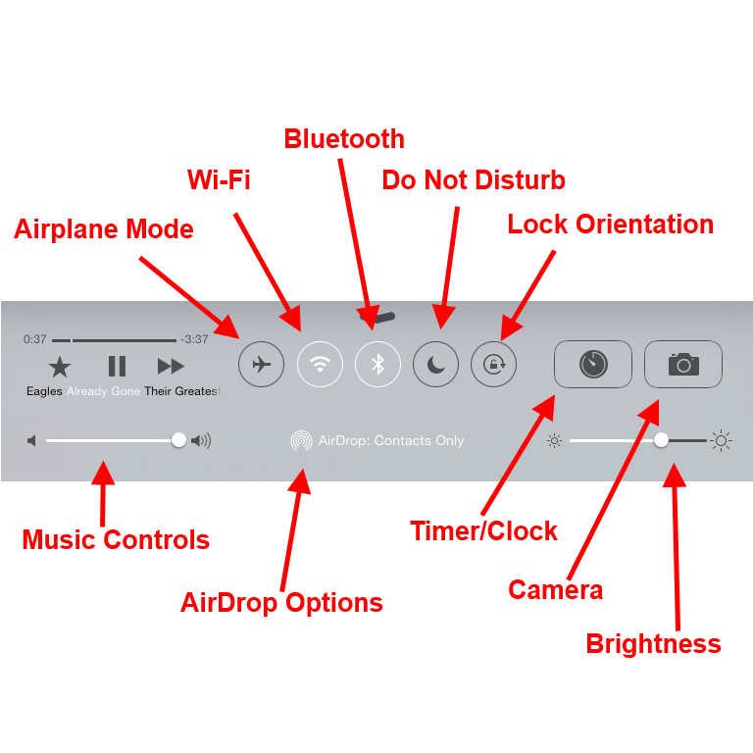
iPad Control Panel

Slide 5
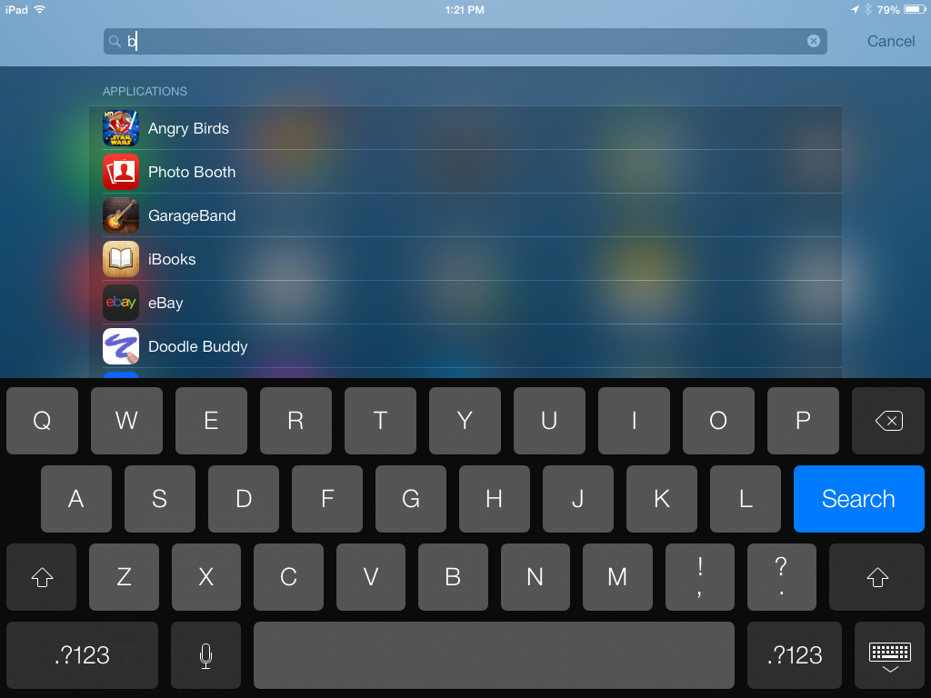
Spotlight Search

Slide 6

Bloomin’ Apps
Kathy Schrock’s Bloomin Apps Interactive Tool
http://www.schrockguide.net/bloomin-apps.html

Slide 7
Using iPads as a Presentation Tool
AirDrop
Air Server
NearPod

Slide 8



Using iPads as a Presentation Tool
AirDrop
Air Server
NearPod

