Slide 1
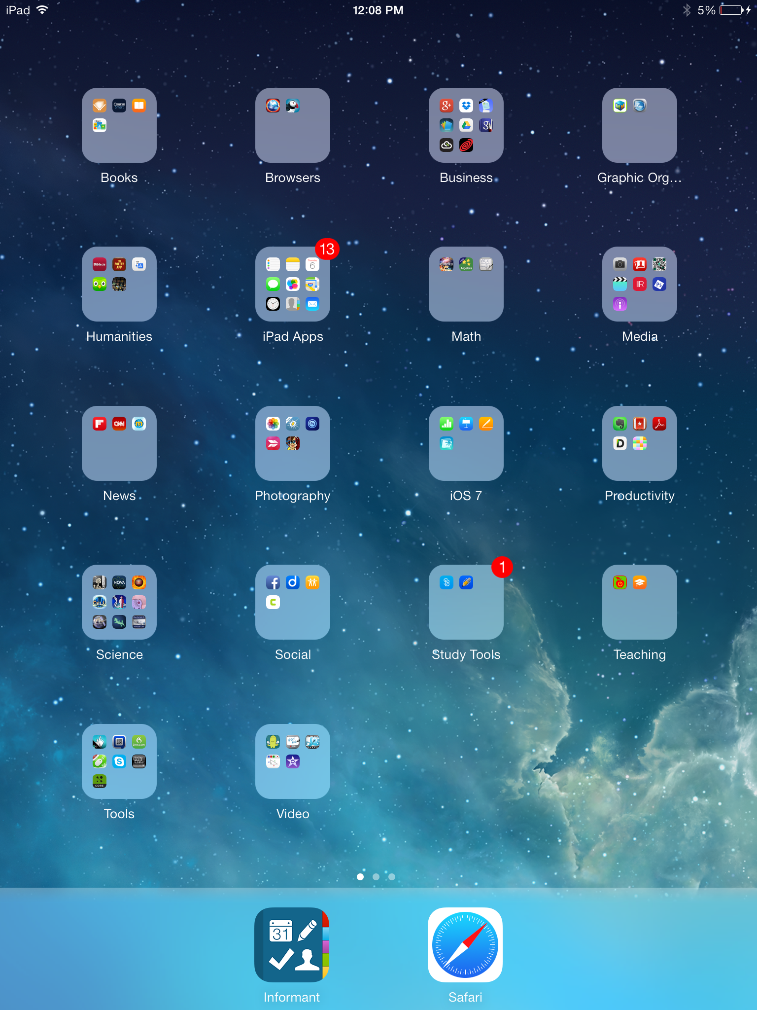
iPad Basics
for Beginners

Slide 2
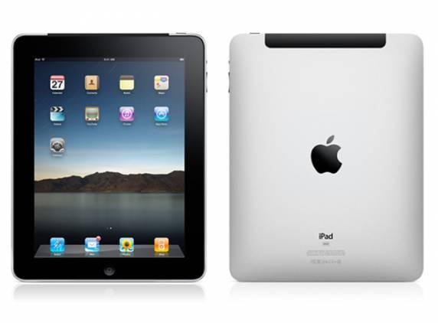
Buttons and Switches
Power button - press and hold to completely shut down
Headset jack
Cameras
Speakers
Microphone - tiny hole on top
Volume
Side Switch - for either Mute or Lock Rotation
Home button - for returning to home screen, waking up iPad

Slide 3
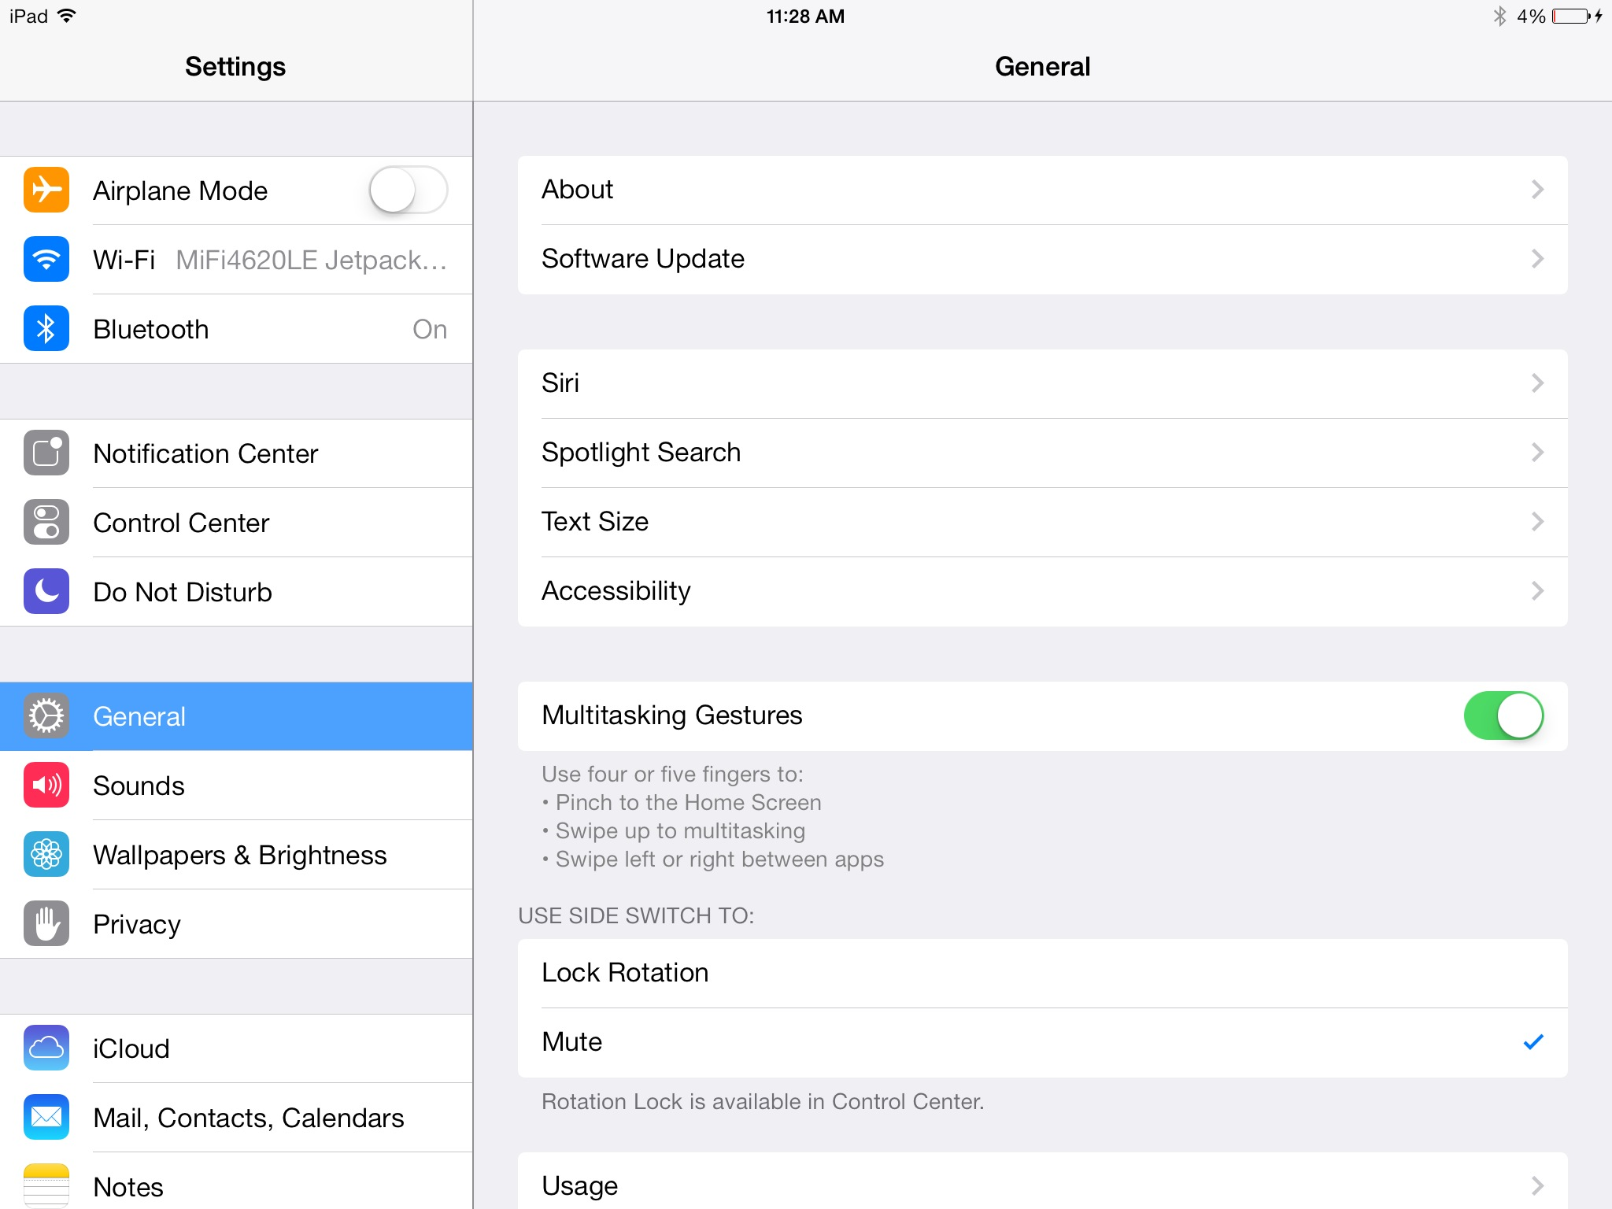
Notes:
General tab:
About - gives general information about the iPad, including name, space, and serial number
Sounds - change sounds for features like texts and emails
Auto-Lock - determines when the iPad goes to sleep
Passcode Lock - sets a four-digit passcode to access the iPad through the lock screen (recommended for admin and teacher iPads)
Side Switch - choose between mute and lock rotation
Reset - choose to reset any or all settings
Bluetooth - for connecting to Bluetooth enabled accessories

Slide 4
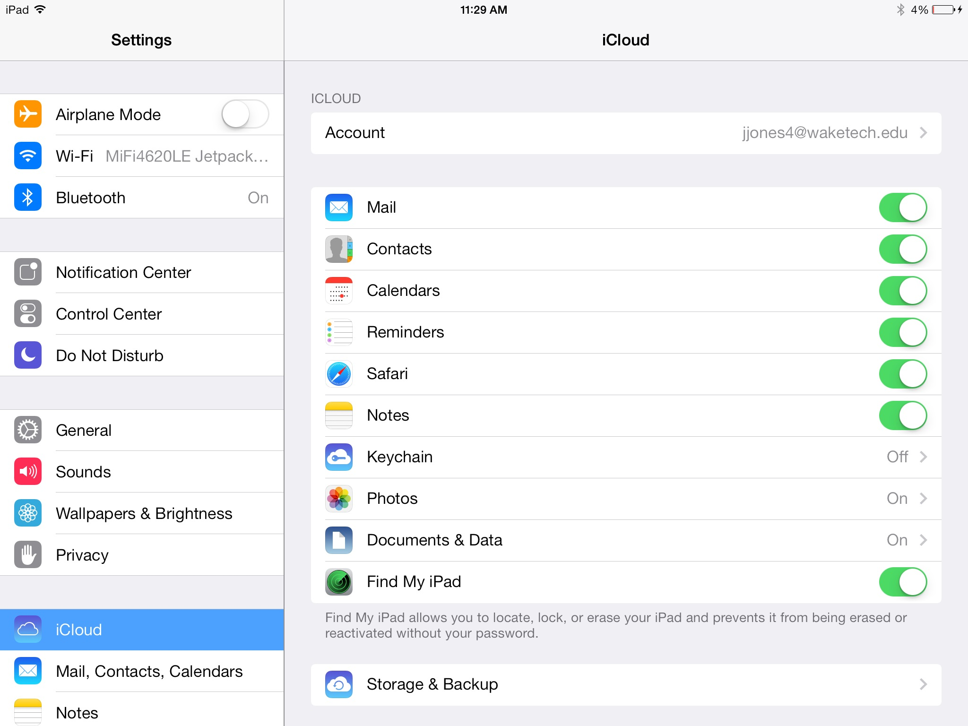
Notes:
iCloud tab:
log in with your Apple ID and set up iCloud to store and backup your mail, contacts, app info, photos, etc
Mail, Contacts, Calendars tab:
Set up and manage Mail accounts (gmail, yahoo, etc)
Notifications tab:
Choose what apps are included in the Notification area (pop up when you have an email, FaceTime call, text, etc.)
Store tab:
Sign in/out to iTunes
Set up automatic downloads of apps, music from any purchasing device

Slide 5
Navigation
Screens - swipe left or right to access new screen (little dots on the bottom of the pages show what screen you are on)
Moving/Deleting apps - press and hold on any app until they all start wiggling around
  Press the "X" to delete the app
  Move any app to place it somewhere else
Making folders
  When the apps are wiggling, move one app onto another one to make a folder
  Then name the folder
Notes:
Screens - swipe left or right to access new screen (little dots on the bottom of the pages show what screen you are on)
Moving/Deleting apps - press and hold on any app until they all start wiggling around
Press the "X" to delete the app
Move any app to place it somewhere else
Making folders
When the apps are wiggling, move one app onto another one to make a folder
Then name the folder
***Apps can only be in one place at a time
***You cannot put folders inside of folders
***You can put 20 apps in a folder

Slide 6
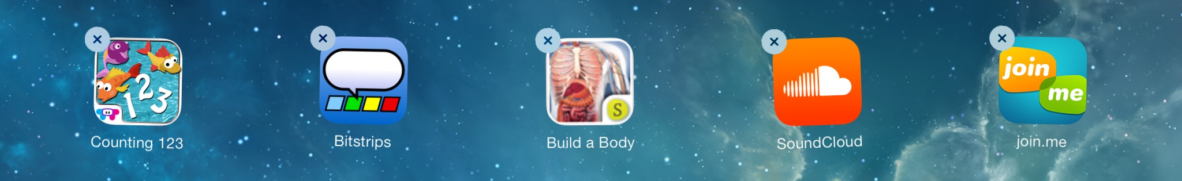
Multitasking Gestures
Use four or five fingers to ...
Pinch in an app to get back to the home screen
Swipe up on any screen to reveal the multitasking bar
Swipe left or right to move between open apps
Press twice on the home button to reveal multitasking bar
Press and hold any of those apps
Press the red minus tag to close apps
Notes:
**Any app you open will remain open and listed on the bottom bar until you manually close it.

Slide 7

Adding websites to your home screen
Go to Safari (your web browser)
Go to URL
Press the rectangle with the arrow on it
Choose "add to home screen" and then modify the name to suit your needs
The link will move to your home screen for easy access

Slide 8

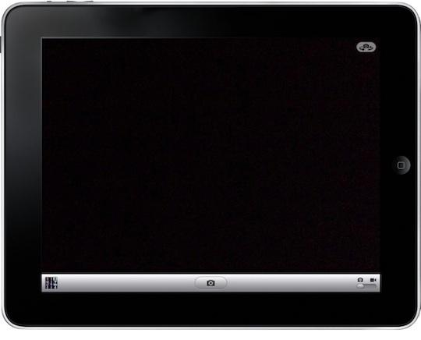
Camera
Open the Camera app
Toggle between front and back camera
Access your camera roll
Take a picture
Toggle between stills and video

Slide 9
Screen shots
To take a screen shot, hold and release the power button and home button simultaneously
The image will be sent to your camera roll
Photo Stream
Activate through iCloud with your Apple ID
Is a temporary holding location for images - 30 days
All your devices synced to iCloud will have access to all your pictures
Move pictures from your Photo Stream to your device for permanent storage

Slide 10
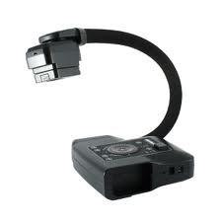


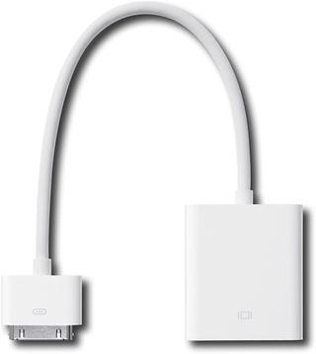
iPad Display Options
Document Camera
Connect to computer
Show "video" of screen
Airserver app
Wireless
CPS has purchased for district-wide use
VGA Connector
$29.99
Connects to projector cable
Apple TV
$99
Need HDMI projector or an adaptor and network cable to hardwire Apple TV

Slide 11
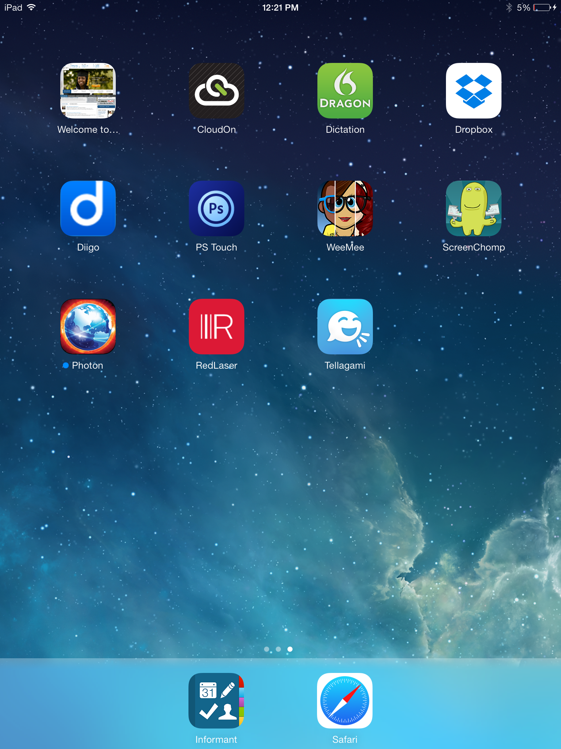
My Favorite Apps
Dropbox – File sharing
CloudOn – Productivity app
Diigo – Social bookmarking
Imformant – Calendar and planner
Tellagami – Avatar video app
Photon browser – Access flash files on iPad
ScreenChomp – Whiteboard recorder
PhotoShop Touch – edit pictures

Slide 12


