Slide 1
Making Online Courses Accessible
Tips for creating an accessible course

Slide 2
Session Overview
Key Elements of Accessibility
Accessible Course Components
  Course Design
  Syllabus
  Rubrics
  Content
  Assessments
Examples of Inaccessible Course Content

Slide 3

Key Elements of Accessibility - POUR
Perceivable
Operable
Understandable
Robust
Notes:
The key elements of accessibility can be defined using the POUR principles. These are perceivable, operable, understandable, and robust. Perceivable means that items are available through sight, hearing, or touch. Operable means that the content is compatible with a keyboard, mouse, or other devices. Understandable requires that the content be user-friendly and easy to comprehend. The last element, robust, ensures that the content works across browsers, assistive technologies, mobile devices, etc.
The next few slides will explore these elements as they relate to online courses and Moodle.

Slide 4
Accessible Course Components
All elements of a course must be accessible. Pay close attention to these areas:
  Course Design
  Syllabus
  Content
  Assessments
Notes:
All elements of a course must be accessible. Accessibility begins with planning the course. Using the principles of Universal Design for Learning when building your course, will help to ensure that the needs of all students are met. After your course, UDL should carried into the other components of the course including the syllabus, rubrics, course content and assessments. Let’s look at some ways to build your course based on UDL and accessibility.

Slide 5

Course Design
Good course design seeks to reduce the number of barriers that students face in online learning.
What are some barriers to learning that your students face?
Notes:
When planning your course, consider all the barriers that students face. What are some of the barriers that your students face? Answers could include - access to internet, computer and laptop variances, browser type, experience in online courses, time constraints, language barriers, learning disabilities, and physical disabilities. Note that these barriers are not limited to students with disabilities, but all students will face some type of barrier to learning. The course design, should take these barriers into account and help to reduce as many as possible. Some of the ways that instructors can reduce barriers is consistent course design, course schedule, help areas, or course orientation.

Slide 6
Barriers to Learning
Access to the internet
Adequate technology
Time constraints
Experience with online courses
Learning disabilities
Physical disabilities
Every course has barriers to learning, but in online courses, these can be multiplied.

Slide 7
Reducing or Eliminating Barriers
Access to the internet – provide a link in the online course to on campus computer labs
Adequate technology - provide a link in the online course to on campus computer labs; include link to technical assistance or help desk
Time constraints – using rubrics, course schedules, and reminders will help students to better manage their time
Experience with online courses – provide a course orientation, consistent module design, and course updates
Learning and physical disabilities – ensure that the course and content meet the guidelines of WCAG
Notes:
Go through the list of barriers and have participants identify ways to eliminate or reduce these barriers through course design. Here are some examples
Access to the internet – provide a link in the online course to on campus computer labs
Adequate technology - provide a link in the online course to on campus computer labs; include link to technical assistance or help desk
Time constraints – using rubrics, course schedules, and reminders will help students to better manage their time
Experience with online courses – provide a course orientation, consistent module design, course updates
Learning disabilities
Physical disabilities

Slide 8

Creating an Accessible Syllabus
Elements of an accessible syllabus include:
  Reading Order
  Heading Styles
  Table Headers
  Alternative Text for Images
  Learner Resources
  Source: California State University Chico: Accessible Syllabus Checklist
  http://www.csuchico.edu/tlp/accessibility/syllabus/checklist.shtml
Notes:
The syllabus serves as the road map of the course. Ensure that the syllabus is accessible and provides students with the information needed to successfully navigate the course. These elements include:
Reading Order
Heading Styles
Table Headers
Alternative Text for Images
Learner Resources
Open the Accessible Syllabus document and go through each of the elements listed. (Keep in mind this a is a one-hour presentation, so time may not allow for specifics on each element, just an overview; the online supplemental material will cover the details and how-to’s.)

Slide 9
Accessible Course Content
Context: Do learners have the background knowledge to understand what is being said?
Concrete: Is the language clear? Are examples relevant? Can learners picture in their minds what is being said?
Simplicity : Are important ideas in logical order?
Design: Is the material easy to look at with enough white space?
Readability: Does the level of the material match the intended audience?
Notes:
Resources:
http://www.plainlanguage.gov/index.cfm
http://www.plainlanguage.gov/resources/index.cfm

Slide 10
Accessible Course Content - Documents
Headings Nested Properly
Lists Used Correctly
Simple Tables
Chunked Content
Adequate Color Contrast
Do Not Use Color Alone
Notes:
Brief overview, hand out Accessible Word 2013 document or show them where it is located in the online course. Show how to use the Accessibility Checker in Word.

Slide 11
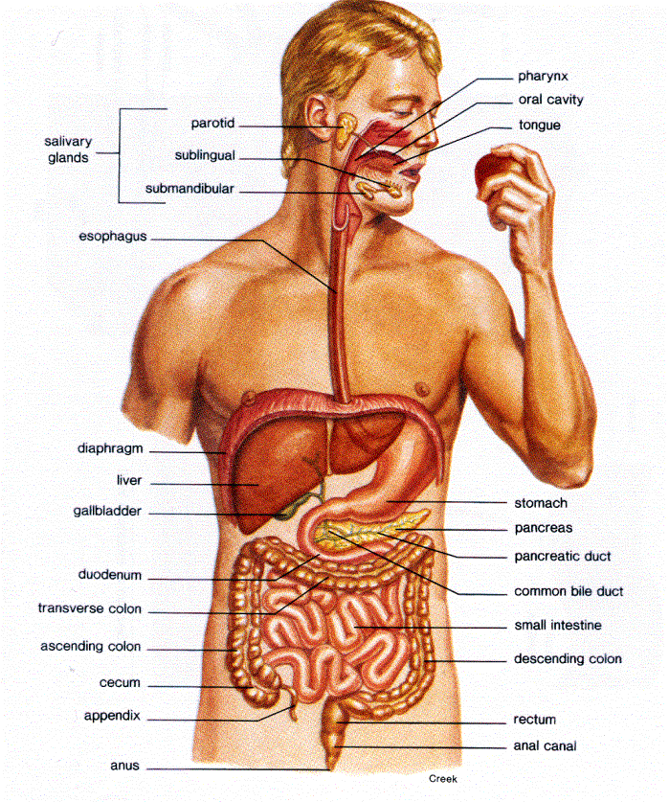
Accessible Course Content – Audio & Videos
Instead of pointing to parts of the body and saying “here, here, here” consider something like…in the top right quadrant at one o’clock.
Make sure all materials are available to more than one sense.
  Audio
  Captions and Transcripts
Notes:
Instead of pointing to parts of the body and saying “here, here, here” consider something like…in the top right quadrant at one o’clock.
Review guidelines for captioning for videos and transcripts for audio

Slide 12
Accessible Course Content – Images
Make sure all materials are available to more than one sense. For images and tables, this includes alternative text and/or long descriptions.
Notes:
Show how to add alt text to an image in Word or PowerPoint

Slide 13
Accessible Course Content - Assessments
Design assessments with UDL in mind
Assessments should align with course outcomes
Use rubrics
Provides options for completion of assessments
Vary type and submission format of assessments
Ensure that tools, technology, and resources used to complete assessments are accessible to all students.
Notes:
When planning and designing assessments, keep the principles of UDL in mind. Assessments should be varied in format and submission format. For example, assessments can include objective tests, projects, case studies, video creation, student presentation, and much more. By varying the type and format of the assessment, students are able to showcase their skills. UDL looks at varying abilities among students, not just disabilities.
Give students options for completing projects and assessments. For example, a class presentation on a topic doesn’t have to be a an oral presentation at the front of the class or just a powerpoint presentation. It could include a video that student or a group creates using web based presentation tools (some examples – Capzules, Prezi, Jing, etc). Other examples, could be a website that organizes content and information. Students can post videos and links that demonstrate their knowledge and skills, but allow them to highlight their abilities.
When sending students to external websites and resources, be sure that these sites are accessible as well. Tools such as the WebAIM site checker or tool bar will assist in evaluating sites.
http://wave.webaim.org/

Slide 14
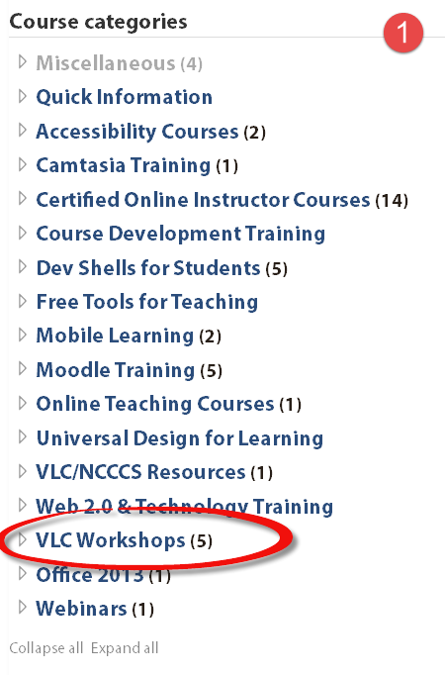
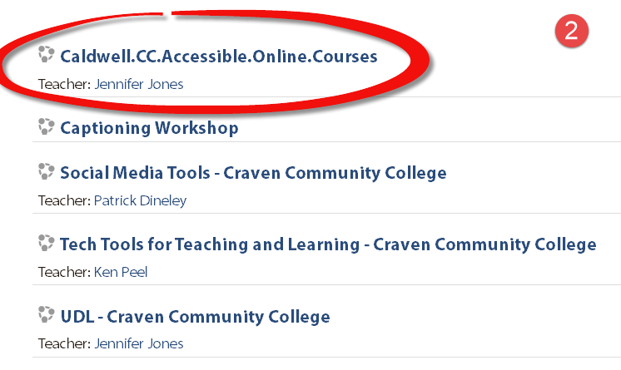
For additional resources, visit: http://vlcpdmoodle.nccommunitycolleges.edu
Notes:
The additional resources are located online in the VLC PD Moodle server at http://vlcpdmoodle.nccommunitycolleges.edu . Navigate to the site, and then select the VLC Workshops Category. Next open the Caldwell CC Accessibility Course. The course has guest access so no login is required.

Slide 15

Questions

