Slide 1
Access for All Students for eLearning Success
NCCCS Virtual Learning Community (VLC)

Slide 2
Overview
Why make content accessible?
  Equal Access
  Regulations
  Standards
  Lawsuits/Resolutions
  Assistive Technology
Who is a student with a disability?
  Types of Impairments
Model of Reform
Steps to Accessibility
Questions?

Slide 3
Why do we need to make online content accessible?
Federal Regulations
State Regulations
It’s the Right thing to do!
Lawsuits are expensive!
  Disability Rights groups are helping students to file lawsuits
BUT -- The number one reason for making online content accessible is to allow people to access your services and your content effectively and easily. It is not just to meet a series of checkpoints.
Notes:
When considering whether a website provides equal access to people with disabilities, you really have to figure out what programs, services, or activities are being delivered via the website or distance learning vehicle, then go through all aspects of that online program, service, or activity to figure out whether people with disabilities have an equal opportunity to participate fully in the program, service, or activity.
You should consider such things as whether persons with disabilities have the same ease of use, completeness of information and functionality, and timeliness of response.

Slide 4

Basic Philosophy
All students, regardless of disabilities or learning styles, need access to websites and electronic/digital content to be successful in college!
eLearning allows the citizens of NC to “Learn. Virtually Anywhere.” (the Virtual Learning Community trademark) in order to advance their career and educational goals… even those with special needs!
Whether in a F2F class or online, students need to access digital content and websites to succeed.

Slide 5

What is Equal Access?
OCR’s guidance on emerging technology sets the standard:
“Receive all the educational benefits provided by the technology in an equally effective and equally integrated manner”
Must be able to:
  Acquire the same information,
  Engage in the same interactions, and
  Enjoy the same services.
Colleges should closely review all programs, services, or activities delivered
Are these same activities/services offered over the website/electronically for students with disabilities?
Notes:
The June 29, 2010 Dear Colleague Letter on Electronic Book Readers says:
“Requiring use of an emerging technology in a classroom environment when the technology is inaccessible to . . . individuals with disabilities . . . is discrimination . . . unless those individuals are provided accommodations or modifications that permit them to receive all the educational benefits provided by the technology in an equally effective and equally integrated manner.”

Slide 6
Equal Access
Students must be able to:
  Acquire the same information
  Engage in the same interactions
  Enjoy the same services
Colleges should closely review all programs, services, or activities delivered
Are these same activities/services offered over the website/electronically for students with disabilities?

Slide 7

What are the laws/regulations?
  Section 504 of the Rehabilitation Act of 1973 www.ed.gov/policy/rights/reg/ocr/
Section 508 Summary www.section508.gov/index.cfm?fuseAction=stdsSum
  Title II of the Americans with Disabilities Act of 1990 www.ada.gov/2010_regs.htm
NC regulations under Senate Bill 866 www.ncga.state.nc.us/Sessions/2001/Bills/Senate/HTML/S866v6.html

Slide 8
Regulations
Section 504
  State or local governments may not discriminate against qualified individuals with disabilities. All government facilities, services, and communications must be accessible consistent with the requirements of section 504 of the Rehabilitation Act of 1973. (DOE Office for Civil Rights website: http://www2.ed.gov/about/offices/list/ocr/index.html?src=oc)

Slide 9
NC Senate Bill 866
"§ 168A-7. Discrimination in public service.
(a) It is a discriminatory practice for a State department, institution, or agency, or any political subdivision of the State or any person that contracts with the above for the delivery of public services including but not limited to education, health, social services, recreation, and rehabilitation, to refuse to provide reasonable aids and adaptations necessary for a known qualified person with a disability to use or benefit from existing public services operated by such entity; provided that the aids and adaptations do not impose an undue hardship on the entity involved. This subsection includes equivalent services provided via information technology.
(b) A State department, institution, or agency, any political subdivision of the State, and any person that contracts with these entities for the delivery of public services shall administer its services programs, and activities in the most integrated setting appropriate to the needs of persons with disabilities."

Slide 10

What does the Senate say about Accessibility?
Access to Technology Senate Hearing (opens in new window)

Slide 11

What are the standards?
Section 508 Checklist
  http://webaim.org/standards/508/checklist
Web Content Accessibility Guide 2.0 Level AA
  http://www.w3.org/TR/WCAG/
NC state standard for web accessibility is WCAG 1.0
WCAG 2.0 Level AA is the de facto standard in most resolutions, even those settled outside of court!

Slide 12
What is WCAG?
Web Accessibility Initiative of the World Wide Web Consortium “W3C”
  Public/private world-wide consortium of academics, governments, technology industry, and user groups
Web Content Accessibility Guidelines (level 1)
  Level I is the standard in NC ITS Statewide Technical Architecture documentation (as of 2004) http://www.ea.scio.nc.gov/library/pdf/archives/Application%20Domain%20-%20Principles,%20Standards,%20Practices.pdf
  Standards for NC will be revised within the next 2 years per the ITS Enterprise Architect
www.w3.org/wai
  See “Evaluating Accessibility”

Slide 13
Lawsuits
South Carolina Community and Tech. Colleges
Voluntary Resolution Agreement with DOE in March 2013 to ensure all websites in SCTCS are ADA compliant.
  http://www.ed.gov/news/press-releases/civil-rights-agreement-reached-south-carolina-technical-college-system-accessibi
“OCR found that the sites were not readily accessible to persons who are blind, have low vision, or have other print-related disabilities.“

Slide 14

South Carolina
Under the terms of the agreement, SCTCS and its board will:
  Develop a resource guide that provides information about web accessibility requirements;
  Direct that the SCTCS website and the websites of all the member colleges be accessible to students with disabilities; and
  Annually review the system’s and colleges’ websites and monitor steps taken to correct any accessibility problems identified.

Slide 15
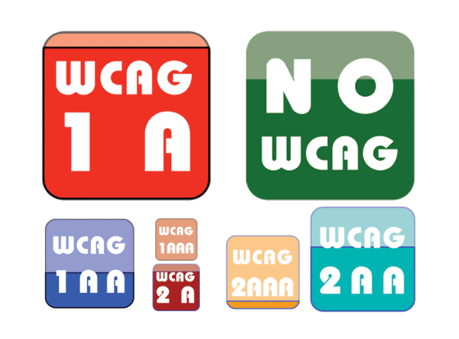
Louisiana Tech. University
Settlement with Dept. of Justice, July 2013
Under the settlement agreement, the university will adopt a number of disability-related policies, including the requirement to deploy learning technology, web pages, and course content that is accessible in accordance with the Web Content Accessibility Guidelines (WCAG) 2.0 Level AA standard
  http://www.justice.gov/opa/pr/2013/July/13-crt-831.html

Slide 16

Penn State University
“November 12, 2010, NFB filed a complaint with the Department of Education regarding Web and other IT used on Penn State campuses. In 2011, this complaint was settled and required Penn State to make sweeping changes to their Web content (it agreed to follow the WCAG 2.0 level AA) and its IT generally (including IT used in classrooms, campus banking, library services, etc.).
  http://blog.hisoftware.com/2013/accessibility/web-accessibility-in-higher-education

Slide 17

San Jose State University
By an agreement signed on January 19, 1996, SJSU agreed to implement a voluntary resolution plan.
Personal reader is not sufficient – flexibility and freedom through software/assistive tech.
“Must also provide training on use” of tech.
http://people.rit.edu/easi/law/sjsu.htm

Slide 18
Must Educators Provide Assistive Technology for Disabled Students to Access Distance Learning Activities?
Generally, no. Think of most specialized computer equipment - “assistive technology” - as being like mobility equipment (wheelchairs, etc.). They are generally the responsibility of the individual with a disability.
However…
If they provide laptops/iPads to incoming students, they must provide accessible equipment with assistive technology to students with disabilities!
If they provide open access computers for student use, they must provide appropriate number with assistive technology

Slide 19

OCR Guidance on Accessible Technology
Joint OCR-DOJ Dear Colleague Letter on Electronic Book Readers (June 29, 2010)
  www.ed.gov/ocr/letters/colleague-20100629.html
FAQ About the June 29, 2010 Dear Colleague Letter (May 26, 2011)
  www.ed.gov/ocr/docs/dcl-ebook-faq-201105.html
Notes:
OCR developed these two helpful policy guidance documents in response to several complaints about schools that were using inaccessible electronic book readers,
These principles in the documents apply broadly to technology, including websites and distance learning, that is used by educational institutions.
These policy documents include several examples that illustrate how educational institutions can comply with the ADA and Section 504 with respect to accessible technology.
Standard: “Requiring use of an emerging technology in a classroom environment when the technology is inaccessible to . . . individuals with disabilities . . . is discrimination . . . unless those individuals are provided accommodations or modifications that permit them to receive all the educational benefits provided by the technology in an equally effective and equally integrated manner.”

Slide 20

Assistive Technology Options
Disability-specific devices that allow people to use computers and other technology:
Alternatives, such as foot pedals, for people who cannot use a computer mouse
Screen readers and refreshable braille devices for people who are blind or have other print disabilities
Open or closed captioning for people who are deaf

Slide 21
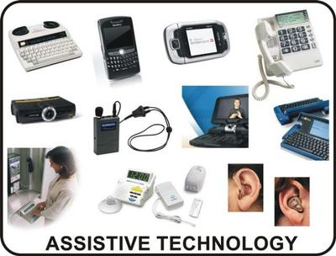
Other Assistive Technologies
Screen Readers including:
  Voiceover for Macintosh
  Jaws for Windows
Adaptive Keyboards
Scroll wheels and large trackballs
Eye Tracking Devices
Voice Recognition Software
Various Prosthetic Devices
Screen Magnification

Slide 22
Websites vs. Distance Learning
Distance learning: the technology supporting “live” courses should be designed to be adaptable (no need to actually provide real-time captioning, if there’s no student who needs captioning currently enrolled, but educators should be ready to do so if a student with a disability joins the class).
Websites: All websites should be designed to be accessible to individuals with disabilities.
The intersection of websites and distance learning: If an archived course is available online upon demand, then it should be captioned before posting – or the educator should be ready to provide another means of effective communication.
Students access an online course through a website/portal!

Slide 23

Who is a Student with a Disability?
Has a physical or mental impairment which substantially limits one or more major life activities, or
Has a record of such impairment, or
Is regarded as having such impairment.
Notes:
Any questions about this?

Slide 24
What types of impairments should we consider in content design?
Visual Impairments – students use screen readers to convert visual information to speech
Hearing Impairments – can’t listen to videos so they need captioning
Mobility Impairments – use speech recognition software or assistive technology to navigate sites, “tab” navigation (no mouse)
Low Vision – need to adjust font or color easily

Slide 25
Benefits
Accessible courses benefit all students.
  Accessible courses, designed with accessibility and Universal Design for Learning (UDL) in mind, are beneficial to all students, not just those with a disability.
Good course design saves time.
  Designing and building your course right the first time, saves time in having to rebuild it later on.
It's the law.
  Online content is required to meet the standards of Section 504 of the U.S. Rehabilitation Act.
Example

Slide 26
Universal Design
Universal Design for Learning is a set of principles for curriculum development that give all individuals equal opportunities to learn.
Goes beyond accessibility for students with disabilities
3 main principles (http://www.udlcenter.org/aboutudl/whatisudl/3principles)
  Provide Multiple Means of Representation
  Provide Multiple Means of Action and Expression
  Provide Multiple Means of Engagement

Slide 27
Model of Reform at a Glance...
Five (5) Years to Compliance (actually 4 left)
Gather baseline information
Gain top-level support
Organize an accessibility committee
Define a standard
Create an implementation plan
Provide training and technical support
Monitor conformance
Remain flexible through the changes
  Every organization will need to adapt this model to it's own circumstances, but the general principles apply across organizations and circumstances.

Slide 28
How do I begin?
Start Small – ADA Forum perhaps
  Awareness and Knowledge Key
Identify all digital content used in instruction
  Instructional websites sites
  Web applications and sites contracted
    Require ADA Compliance statement in all contracts
  Online forms
  PDF files
  Word docs
  PowerPoint files
  Videos

Slide 29
5 Steps to Accessibility
Follow these five steps to make online courses accessible.
Speak Visually
Use Plain Language
Keep it Simple
Select Multi-Sensory Materials
Request Accessible Materials

Slide 30
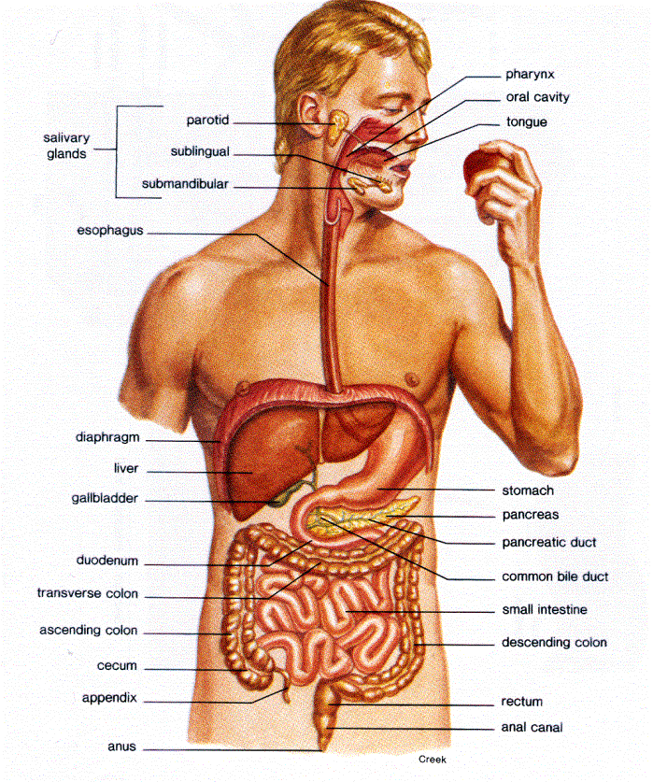

Speak Visually
Notes:
Instead of pointing to parts of the body and saying “here, here, here” consider something like…in the top right quadrant at one o’clock..

Slide 31

Use Plain Language
Context: Do learners have the background knowledge to understand what is being said?
Concrete: Is the language clear? Are examples relevant? Can learners picture in their minds what is being said?
Simplicity : Are important ideas in logical order?
Design: Is the material easy to look at with enough white space?
Readability: Does the level of the material match the intended audience?

Slide 32

Keep documents simple
Headings Nested Properly
Lists Used Correctly
Simple Tables
Chunked Content
Adequate Color Contrast
Do Not Use Color Alone
Notes:
Brief overview, hand out Word Brochure

Slide 33

Make sure all materials are available to more than one sense
Audio
Captions and Transcripts
Alternative Text / Long Descriptions

Slide 34
Why Caption?
Importance of Captioning (opens in new window)

Slide 35

Insist on accessible publisher content
BUYER - BE AWARE!
Ask for a VPAT – the Voluntary Product Accessibility Template…
We are required by law to procure only accessible content, but the publisher is not obligated to provide accessible content…
Notes:
Briefly explain VPAT, discuss holding publishers accountable for third party content.

Slide 36
Voluntary Product Accessibility Template
A VPAT is a vendor-generated statement
that provides information on how a product or service
conforms to Section 508 Accessibility Standards (from the U.S. Access Board) for Electronic and Information Technology
in a consistent fashion and format.
Request VPAT statement in all contracts and purchases for electronic content.

Slide 37
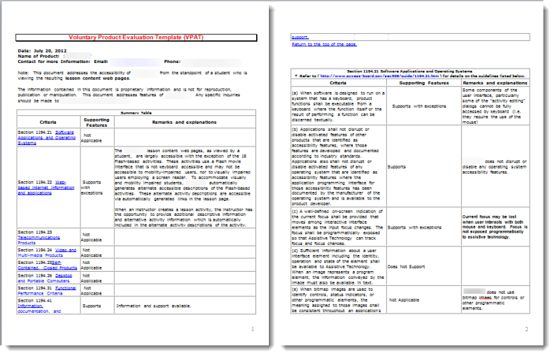
The VPAT

Slide 38
Are Our Tools and Technology Usable by All?
Have We Considered…
Students who are blind or visually challenged?
Students who are deaf or hearing impaired?
Students with physical disabilities?
Students with challenges more difficult to discern?
FACULTY AND STAFF with varying needs?

Slide 39

Potential Problems
Learning Management Systems
Web Pages
Web-based Tools and Resources
Digital Student Services
Publisher Provided Content
All types of technology used by students, staff, and faculty…

Slide 40
The Path to Accessibility…
File formats that are user friendly
Compatibility with Assistive Technology
Text image descriptions that can be voiced
Full keyboard access to Web-based content
Mathematical, scientific, and music symbols, formulas, and notations represented in multiple ways
e-book content that can be voiced and navigated
Purchase Accessible Learning Materials Initiative PALM National Center on AIM at CAST

Slide 41
Resources
National Center on Accessible Instructional Materials
PALM Initiative (Purchase Accessible Learning Materials)
http://aim.cast.org/learn/practice/palm#.VA4fYxaGO5U
Notes:
Review booklet and how to use.

Slide 42

How can the Virtual Learning Community help?

Slide 43
Questions?

Slide 44
Contact Information
Wanda Barker
barkerw@nccommunitycolleges.edu
Candace Holder
holderc@surry.edu
Jennifer Jones
pdcenter@waketech.edu

